Slide 1
Communication Manager

Slide 2
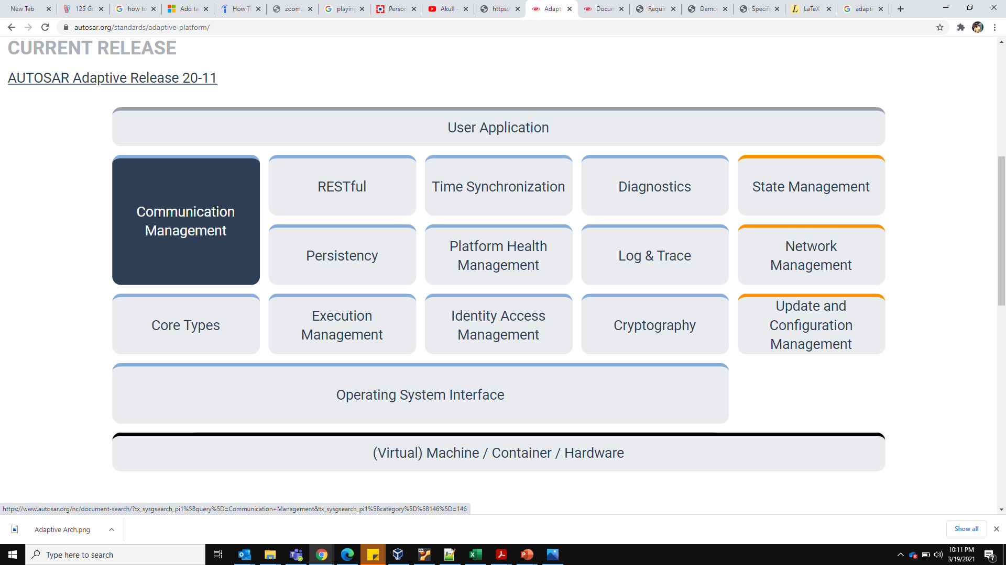
Communication Manager

Slide 3
Communication Manager
The CM provides the infrastructure that enables communication between Adaptive AUTOSAR Applications within one machine and with software entities on other machines, e.g. other Adaptive AUTOSAR applications or Classic AUTOSAR SWCs.
Supports for Dynamic Communication
Use of Service-oriented communication without dependency on a specific communication protocol
Uses the Proxy/Skeleton pattern
C++ interface compatible with C++14

Slide 4
Service Oriented Architecture
Skeleton/Producer
SERVER APP
Ara::com
Proxy/Subscriber
CLIENT APP
SOME/IP
Offer Service
Publishes Event/Field/vent
Find Service
Subscribes
Event/Field/Methods

Slide 5
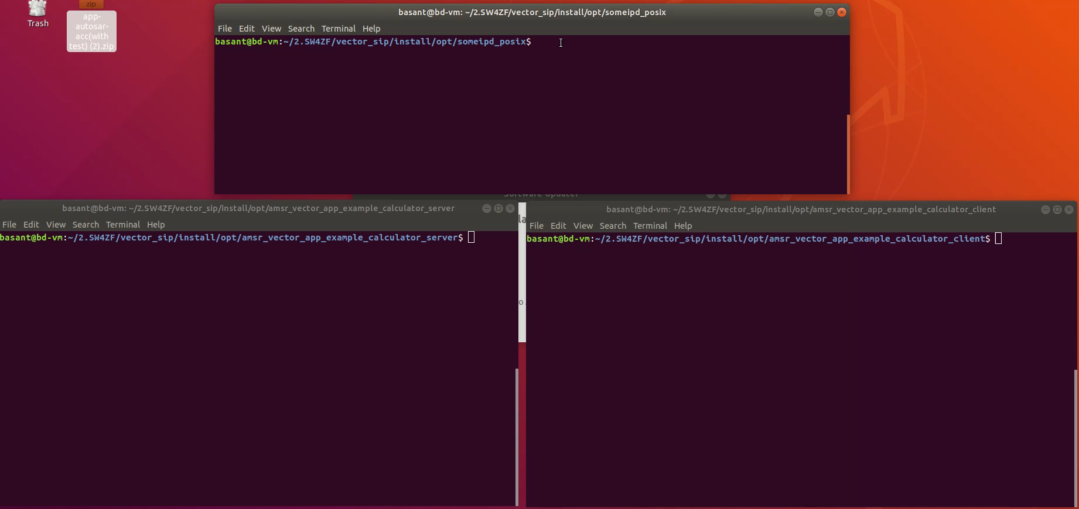

Slide 6
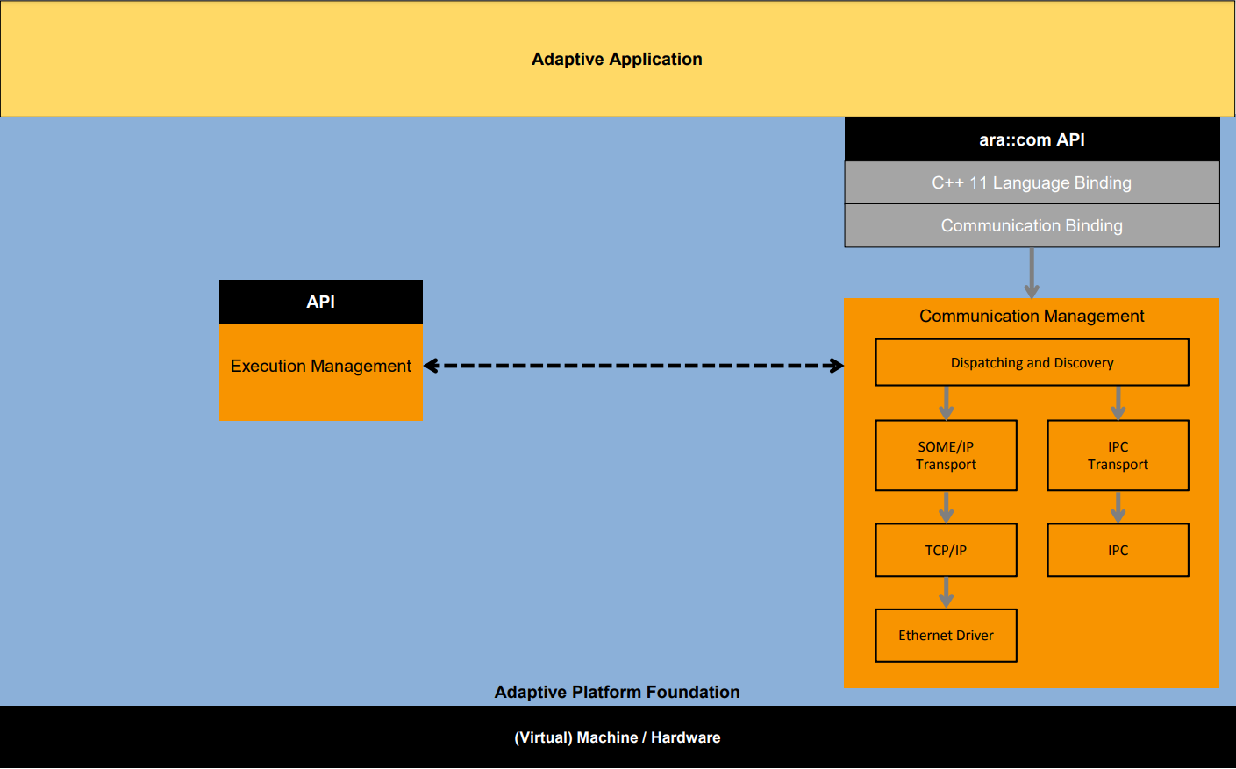
Architecture
Language binding
Communication/Network binding
POSIX-based OS

Slide 7
C++ Language Binding
The language binding defines how the methods, events and fields of a service are used on API-level (C++/11)
Type safe C++ interface
Abstracts from Network binding details
Polling- and event-driven programming styles are supported
Zero-copy capability
Supports safety (e.g. exception-free API subset, end-to-end protection support)
Adaptive Application
Language binding : ara::com
Network binding : E.g. SOME/IP(-SD)
POSIX-based Operating System
Hardware / Virtual Machine / Container

Slide 8
C++ Language Binding: Proxy/Skeleton
The upper layer of the C++ Language Binding contains generated sources for the service interface described in the meta model
A generator will generate C++ classes that contain type safe representations of the fields, events and methods of each respective service
These C++ classes can be divided into Proxy and Skeleton classes:
Proxy: Contains the consumer-side of the respective service interface
Skeleton: Contains the provider-side of the respective service interface
Adaptive Applications will use those generated classes to interact with ara::com
MyServiceInterface
--- int my_field1
--- void my_func()
--- int my_func1()
--- my_event()
…
Consumer: Adaptive Application
Proxy classes
Generator
Provider: Adaptive Application
Meta Model (arxml)
Skeleton classes

Slide 9
SOME/IP(-SD) Network binding
Network binding defines how messages for service discovery, methods, events and fields are getting exchanged for:
Intra-process communication: Process local
Inter-process communication: E.g. POSIX-/QNX-/… IPC
Inter-machine communication E.g. SOME/IP(-SD), DDS RTPS
SOME/IP(-SD) consist of two specifications that are part of the Foundation (FO) documents:
AUTOSAR_PRS_SOMEIPProtocol
AUTOSAR_PRS_SOMEIPServiceDiscoveryProtocol
SOME/IP(-SD) relies on using Ethernet and TCP/IP
Middleware features:
Serialization: Transforming into and from on-wire representation
Service Discovery (SD): Dynamically find functionality
RPC: Remote invocation of functions
Publish/Subscribe: Dynamically configure which data is needed
Segmentation of UDP messages: SOME/IP-TP
Adaptive Application
Language binding : ara::com
Network binding : SOME/IP(-SD)
POSIX-based Operating System
Hardware / Virtual Machine / Container

Slide 10
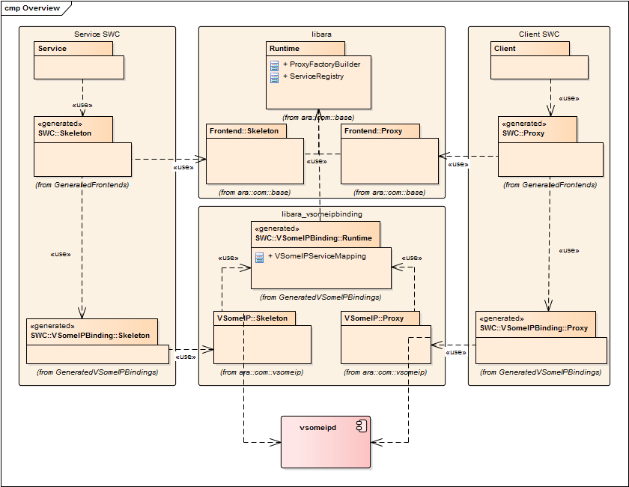

Slide 11
References
https://www.autosar.org/fileadmin/user_upload/standards/adaptive/20-11/AUTOSAR_RS_CommunicationManagement.pdf
https://www.autosar.org/fileadmin/user_upload/standards/adaptive/20-11/AUTOSAR_SWS_CommunicationManagement.pdf
https://www.autosar.org/fileadmin/user_upload/standards/foundation/1-2/AUTOSAR_PRS_SOMEIPServiceDiscoveryProtocol.pdf

Slide 12
Thank You

